Slide 1
Computer System Overview
Chapter 1
Last Updated 1/8/2018 12:29 PM

Slide 2
Basic Elements of a Computer System
Processor: Interpreters and executes program instructions.
Also know as Central Processing Unit
Main Memory: Volatile memory that maintains instructions and data. AKA Primary Storage or RAM (Random Access Memory)
Secondary Storage: Persistent (disk) storage for programs and data.
System Bus: Interconnects the CPU with Memory, I/O Devices, and other peripherals.
USB is type of system bus.
Notes:
Modern processors are multi-core, capable of executing multiple instruction streams in parallel (concurrently).

Slide 3
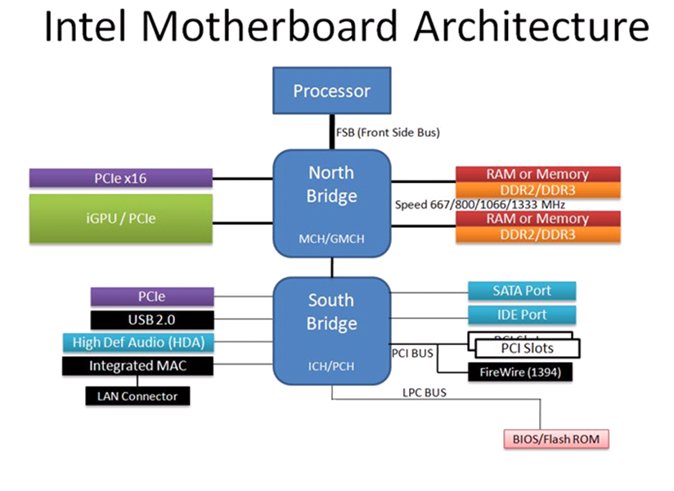
Notes:
Front Side Bus: The high-speed bus that connects the processor to memory (and GPU) as show above.
SATA / IDE: Physical interfaces to disk drives.
Integrated MAC: The network (LAN) adapter.
Super I/O: Outdated hardware interfaces that have been replaced by USB devices.
iGPU: Graphical Processing Unit or the monitor / display ad

Slide 4
Intel Motherboard Architecture
North Bridge Controller: Interfaces to ‘fast’ devices.
Interface to Memory through the Memory Management Unit (MMU)
Graphics Processing Unit (GPU)
South Bridge Controller: Interface to slow devices.
Disk Drive through Disk Controllers
Network Interface Controller
I/O and USB Controllers
Graphical Processing Unit (GPU): A sub-system dedicated to the rendering and presenting graphical images.
Can also be used for high-performance data processing.
Notes:
North and South Bridge controllers are of most interest in this course.

Slide 5
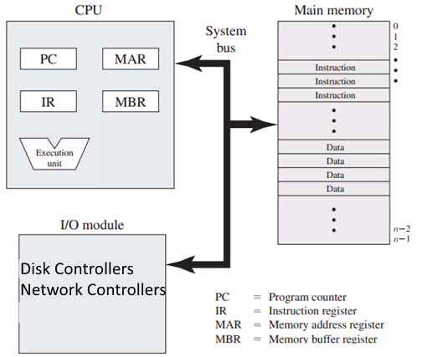
Generic Processor Register Architecture
PC: Maintains the address of the executing instruction.
IR: Maintains the currently executing processor instruction.
AC: Maintains the result of the last arithmetic instruction.
Accumulator (not shown).
SP: Maintains the address of the top of the control stack.
Stack Pointer (not shown).
MAR: The memory address to be accessed.
MBR: The value read from or written at the MAR address.
Notes:
Memory addressing is of interesting throughout this course.

Slide 6
Random Access Memory
Random Access Memory is addressable words that is used to hold program instructions and data.
The memory word size is amount of data that is transferred to or from the processor in a single read or write instruction cycle.
A system’s word size may be 8, 32, 64 bits wide (and even wider).
The processor’s word size is determined by size of the Memory Buffer Register.
The amount of addressable memory (address range) is determined by the width of the Memory Address Register.
64 bits is common today, potentially addressing 18 quintillion words (1.8446744e+19).

Slide 7
A Program’s Memory is Divided into Three Regions / Utilizations
Program (Instruction) Memory maintains the program’s executable instructions.
Heap Memory maintains the program’s data.
Typically, heap memory is allocated to a program by the operating system.
Control Stack Memory maintains the stack used by each thread in the program.
The stack used to push arguments and pop the results of a function (subroutine) call and interrupt handlers.

Slide 8
Processor Instructions
Recall that a program’s source code is compiled into machine instructions and packaged (linked) into an executable file.
When requested, the operating system loads the machine instructions from the executable file on disk into main memory for the processor to execute.
Instruction Categories include:
Processor-Memory: Transfer data to/from the processor and memory.
Processor-IO: Transfer data to/from the processor and an IO module.
Data Processing: Perform a arithmetic or logical operation on the data.
Control: Alter the flow of instruction execution e.g. a branch.
Notes:
Some instructions can only be executed by the operating system’s code.

Slide 9
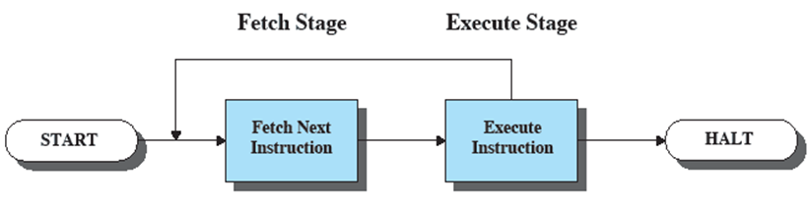
Instruction Execution Cycle
Execution of each instruction occurs in two stages:
1. Fetch the ‘next’ instruction referenced by the program counter from memory into the Instruction Register.
2. Execute the instruction.
This cycle continues until the processor is halted.

Slide 10
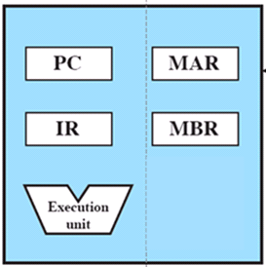
Instruction Execution
The Program Counter maintain the memory address of the instruction.
The instruction is copied from memory into the Instruction Register.
The PC is incremented to the next instruction address.
The Instruction Register’s contents cause the Processor to execute a specific operation according to the Processor’s internal programming.
The processor’s microcode instructions.
Note: The instruction may set the PC to a new instruction address.
This is how the branch instruction works.

Slide 11
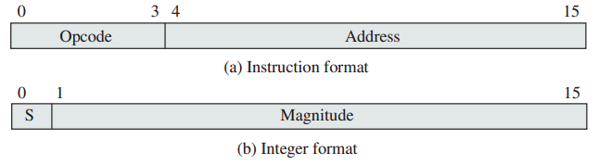
Simplified Instruction and Data Word Formats
This instruction includes an operation code and data.
The opcode describes the operation to perform with the data found at address. For example:
0001 – Load AC with value at Address.
0101 – Add AC to value at Address and store result in AC.
0010 – Store value in AC to Address.

Slide 12
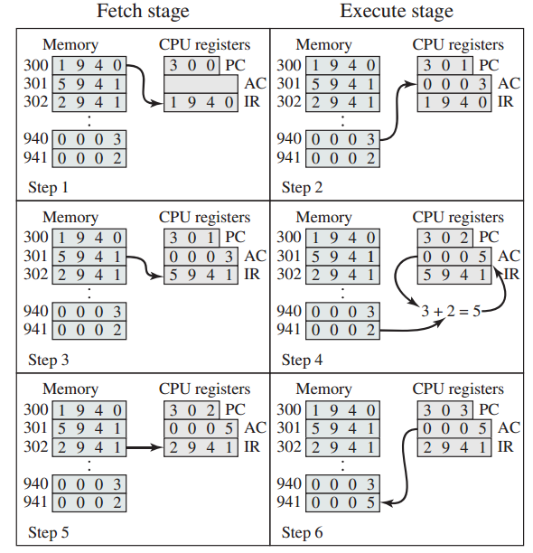
Execution of LOAD, ADD, and STORE instructions
Fetch Stage
Execute Stage
LOAD Instruction
ADD Instruction
STORE Instruction
Notes:
Refer to the OP (operation) codes on previous page.
The thing to notice is that each instruction might make several changes to the processor’s state i.e. execute several sub-operations.

Slide 13
Processor Interrupts
An interrupt is a hardware signal that causes the processor to ‘interrupt’ its normal processing of a program’s instructions.
An IRQ pin that triggers the processor’s interrupt handling routine.
The interrupt mechanism allows the processor to respond to asynchronous events.
Events that occur in a spontaneous / unpredictable fashion.
Interrupts are usually triggered by devices or events that are external to the processor.
But some types of interrupts are generated by the processor e.g. software interrupts or floating point errors.

Slide 14
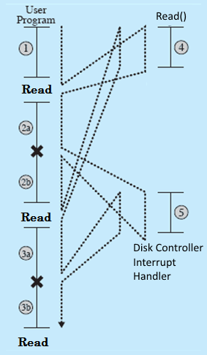
Disk READ Operation with Interrupts
2 & 3 represent the application’s execution which includes READ operations from disk.
4 represents the configuration of the disk controller to read data. The processor then returns to executing program instructions.
X represents the disk controller interrupting the processor notifying that the read operation is complete and the data is ready.
5 represents the processor reading the data from the disk controller’s data buffer.
Between READ and the device’s interrupt, the processor is free to execute million of program instructions during the several milliseconds the disk needs to retrieve the requested data.
Notes:
Freeing the processor from having to poll (query) device controllers to determine when an requested operation has completed is another advantage of processor interrupts.
Note that in reality the processor that makes the READ request is not going to continue execution while the READ is processed (because the program is blocked waiting for the data to be returned). However, during the time that the disk is retrieving data for Program A, the processor can be freed to execute instructions for other programs.

Slide 15
Notifications of Asynchronous Events
Interrupts indicate an Asynchronous Event i.e. events that occur independently of the main program flow.
Events that can occur at any point in time.
Examples of these events include:
A key press or mouse movement.
A disk drive controller that requires attention.
A packet (network message) received by the network controller.
The OS heartbeat timer signal.
The interrupt causes the processor to execute a ‘handler routine instructions’ that examines the interrupt and executes code designed to respond to the specific event.
Notes:
Detection of and processing of asynchronous events is made possible (is an advantage of) with the use of processor interrupts.

Slide 16
Device Polling Wastes Processing Resources
Without interrupts, how can the processor determine that system’s hardware requires its attention?
For example, that the network controller has received a packet of information that must be ‘processed’.
Without interrupts, the processor would need to query / poll the device controllers.
Repeatedly query the controller’s status to know when a packet has arrived, a disk block is read, a key is pressed, etc.
Device Polling waste processing resources which would be better spent executing user programs.

Slide 17
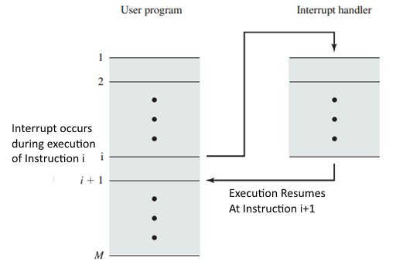
Interrupt Handling
When the processor receives an interrupt, it redirects its execution to a specific set of handling instructions.
The operating system is responsible for providing the interrupt handling instructions.
The operating system determines which device generated the interrupt and executes a device-specific interrupt handler.
Once the handler is finished, the operating system resumes execution of the interrupted program.

Slide 18
Interrupt Processing
Note that once the interrupt handler has completed, execution resumes at instruction i+1 in the following example.
Interrupt handling saves the state of the program’s execution and restore the state when the program resumes execution.
The handling of the hardware interrupt signal begins with pushing the Program Status Word (PSW) and the Program Counter (PC) onto the Control Stack (SP).
Where they can be restored when program execution continues.
Program Status Word is the data that describes the processor’s state (flags, register contents, and other values).
See “Interrupt Processing” on Page 19 in the book.

Slide 19
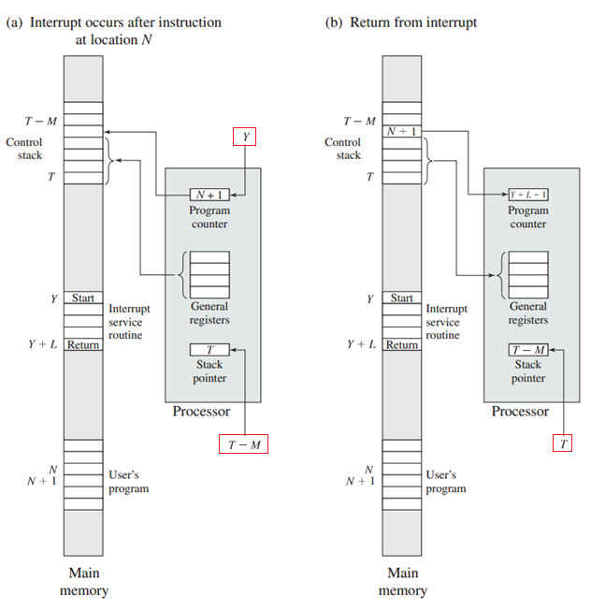
Stack
Grows
Notes:
The processor’s state is pushed onto the control stack in the range T – T-M (The stack grows up towards word 0).
Y – Represents the address of the first instruction of the interrupt handling routine.

Slide 20
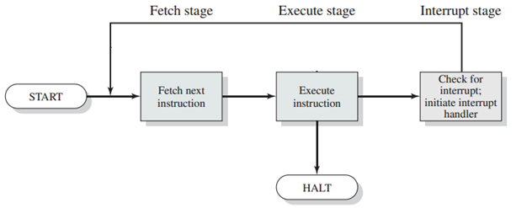
The Interruptible Instruction Cycle
An interruptible instruction cycle is shown below.
After the current instruction has been completed and before the next instruction is fetched, the processor checks if an interrupt has been signaled (INTR) and executes the handling code if so.
The instruction can not be interrupted in mid-execution.
Notes:
While it is possible to disable the processor’s instruction handling, this is not normally done.

Slide 21
Interrupt Priorities
Not all device interrupts are created equal; some interrupts are more important than others.
An interrupt from the network controller has a higher priority than the disk controller because data received from the network may be lost (buffer overflow) if not promptly retrieved from the controller.
The operating system configures the interrupt controller (PIC) with the priority for each of its incoming interrupt lines.
See Slide: Interrupt Controller Hardware
An interrupt of higher priority can interrupt the processing of a lower priority interrupt.
In the following slide, the disk interrupt handler can be interrupted by both the network controller.

Slide 22
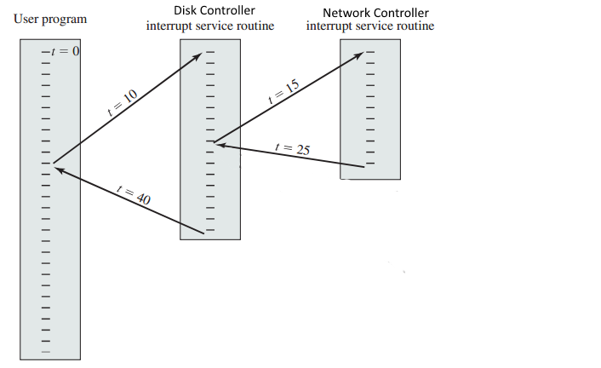
Network Controller > Disk Controller Priority

Slide 23
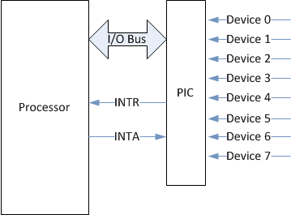
Interrupt Controller Hardware
Devices signal interrupts using digital hardware signals.
A Programmable Interrupt Controller (PIC) is a hardware component that receives interrupt signals from system devices and communicates with the processor.
The Programmable Interrupt Controller :
Allows for a large number of devices in the system design.
Allows for nested interrupts.
Can be programmed to prioritize device interrupt handling.
Intel’s architecture has the PIC integrated into the South Bridge.
Notes:
http://en.wikipedia.org/wiki/Advanced_Programmable_Interrupt_Controller

Slide 24
Sources of Processor Interrupts
I/O Events: Signals the arrival of new information
User input devices e.g. USB keyboard or mouse.
Device Interrupts: A signal from a device controller that indicates it needs attention e.g. disk or network controller.
Timer: Signals at regular intervals used by the operating system to schedule processes or execute scheduled tasks.
Program Execution: Signals invalid execution of the user’s program e.g. accessing memory not owned by the program.
Software Interrupts: Processor instructions that trigger the same processing as a hardware-generated interrupt.

Slide 25
I/O Techniques
Consider a network controller that is receiving a stream of media data e.g. a MP3 stream.
How to most efficiently transfer the data from the controller’s internal buffer into processor memory?
This represents a copy from one block of memory to another i.e. from the network controller’s internal buffer to memory allocated by / owned by the media player program.
The text describes these three options:
1. Programmed I/O
2. Interrupt-Driven I/O
3. Direct Memory Access (DMA)

Slide 26
Programmed I/O
The processor must continuously query (poll) the network controller testing if the controller’s buffer is ready to transfer.
When the controller reports a buffer is ready, the media program must explicitly copy the data from the controller into processor memory where it can be converted into audio.
This operation is repeated hundreds of times a second.
Programmed I/O wastes processor resources because …
1. The processor is continuously polling the network controller.
2. The processor is explicitly copying data from source to destination.

Slide 27
Interrupt-Driven I/O
The system allows the controller to interrupt the processor.
When the controller’s buffer is full, it interrupts the processor whose interrupt handler copies the data to the media player.
The processor is still responsible for copying data from source (controller) to destination (memory).
Interrupt-driven I/O has eliminated the processor polling the controller while waiting for the needed data to arrive.
However, the processor is still occupied copying data from source to destination (This is bad).

Slide 28
Direct Memory Access (DMA)
DMA is a technique of automating the transfer of data from source address range to destination address range.
From controller to memory, or from memory to memory.
The transfer operation (read source, write destination) is performed by a separate system hardware component.
A DMA Controller that operates independently from the processor.
Because the DMA Controller is hardware specialized for data transfer, each transfer operation executes faster than if the processor performed the transfer.
Also, the DMA and Processor can execute concurrently allowing the processor to continue instruction execution.

Slide 29
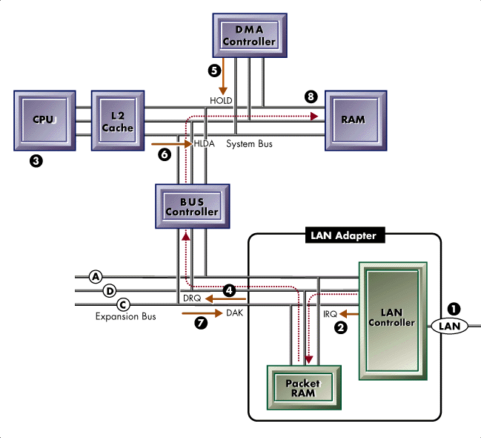
DMA Block Diagram

Slide 30
Direct Memory Access Fun Facts
The Processor must still configure the DMA controller with the source and destination, but is not involved with the transfer.
The DMA controller interrupts the Processor when the transfer is completed.
The Processor and DMA controller share the memory bus.
If the processor’s target memory is in cache (hit) both devices can execute concurrently.
If there is a miss, processor and DMA interleave their accesses so that neither is blocked during the transfer operation.

Slide 31
The Memory Hierarchy
There are several types of system memory i.e. mechanisms used to maintain program instructions and data.
Processor Registers, Processor Cache, Memory, Disks, etc.
Each of these types can be uniquely characterized by:
How much capacity can reasonably be provided?
Their access times (read & write).
Their expense (cost per byte).
Generally, these constraints apply:
The faster the access time the greater the cost per word.
The greater the capacity the smaller the cost per word.
The greater the capacity the slower (greater) the access time.

Slide 32
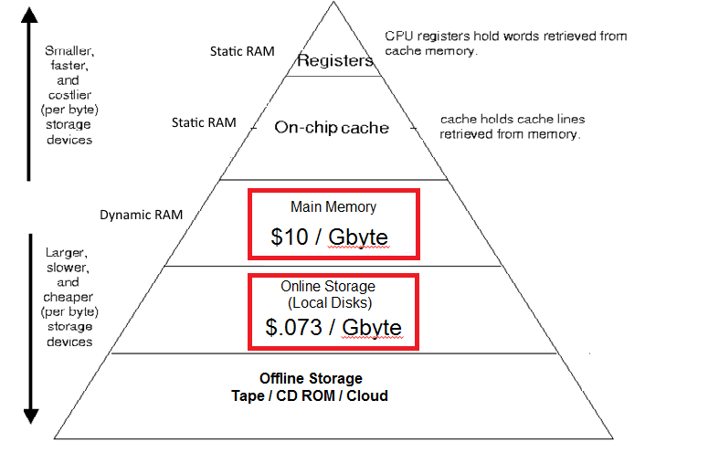
The Memory Hierarchy

Slide 33
Types of Random Access Memory
Static RAM (SRAM): Used for registers and cache memory.
Fastest access speeds.
Takes up more space on the die as each bit requires several transistors; Expensive to fabricate.
Dynamic RAM (DRAM): Used for main memory.
Slower to access that SRAM; Requires constant refresh.
Takes up less space on the die as each bit requires only a few transistors; Less expensive to fabricate.
Disk
Much, much slower to access that DRAM.
Much, much less expensive to fabricate.
Non-volatile (information is retained when powered off).

Slide 34
Access Speed in the Memory Hierarchy
How many processor cycles are needed to access a word?
Registers – 1-2 Processor Cycle
Cache Memory – 10 - 40 Processor Cycles
Main Memory – ~ 200 Processor Cycles (60-100 ns / access)
Disk – Millions of processor cycles (10s of milliseconds).
The more often we find an addressed word (hit) in cache memory, the faster the processor can execute instructions.
Notes:
Actual processors (e.g. Intel I7) have three levels of cache memory L1, L2, & L3. The differences are not relevant to an OS course.

Slide 35
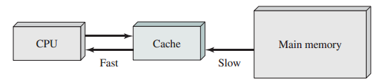
Cache Memory
Cache Memory is fast SRAM memory that lies between the Processor and Main Memory.
This architecture aims to provide memory access speeds approaching the fastest SRAM technology while maintaining larger memory sizes and less expensive DRAM technology.
The cache maintains a small subset of the data maintained in the much larger and slower main memory.
Notes:
The purpose is to increase the speed of instruction execution by allowing the processor to retrieve instructions (and data) from fast SRAM cache memory. Slow dynamic memory takes 200 clock cycles to retrieve a word while fast static memory takes only 20 clock cycles. This increase in access speed is partially due to the fact that the static cache memory is placed on the processor.

Slide 36
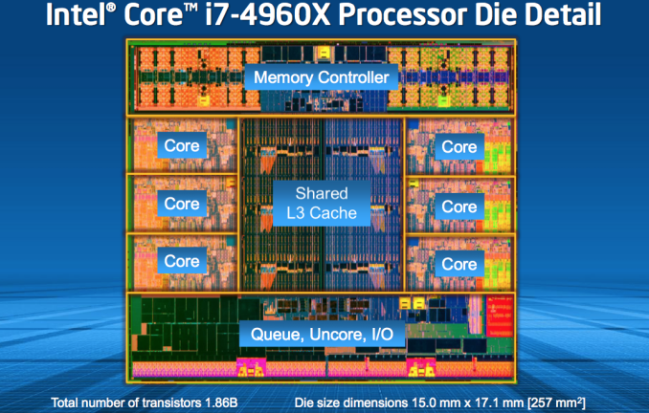
Intel Core i7 Architecture
Cache Memory is placed on the processor’s hardware.
Intel Microprocessor designs includes L1, L2, & L3 caches.
Notes:
Example of a Six Core Processor
Actual processors (e.g. Intel I7) have three levels of cache memory L1, L2, & L3. The differences are not relevant to an OS course.
Interesting Note: 90% of the transistors on the processor die support non-instruction-processing functionality.
See Swanson, S., K. Michelson, A. Schwerin, and M. Oskin. "WaveScalar." 36th International Symposium on Microarchitecture. Proceedings (MICRO-36 2003) 36 (2003).

Slide 37
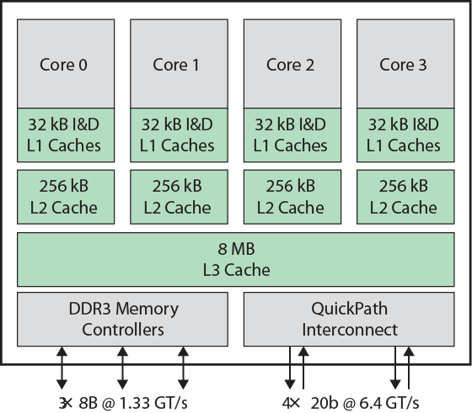
Intel Core i7 Architecture
Notes:
The faster the cache, the smaller the amount available.

Slide 38
The Locality of Reference Principle
During a program’s execution, the memory locations (data and instructions) referenced by the processor tends to cluster.
When an instruction (i) is access during the program’s execution, it is likely that the following instruction (i+1) will be accessed next.
When a data word is access during the program’s execution, it is likely that the same word will be access again in a very short time.
Some functions (methods) will be called many times over the lifetime of a program’s execution. Likewise for certain data.
If these ‘active’ regions of memory are copied into fast cache memory, we will see an improvement in processor performance.
Because fewer processor cycles will be needed to read / write to the memory.
Notes:
Important concepts throughout this course.

Slide 39
Issues of Caching the Program’s Active Regions of Memory
The amount of cache memory is much smaller than the slower main memory.
The system can only maintain a small subset of the main memory in cache.
A program’s active region (i.e. its locality) will move as the program continues executing.
As the program’s execution has moved to a new locality, the memory in ‘cache’ is no longer accessed by the program.
The instructions / data currently in cache must be ‘aged out’ (removed) to make room for the instructions or data in the new active region (the program’s new locality).
Notes:
Maintaining the processor’s cache is entirely implemented in hardware so the operating system does not ‘know’ if a byte is being accessed from L1, L2, etc. or from main memory.
However the Locality of Reference Principle is used to describe the effectiveness of Virtual Memory we will cover later.

Slide 40
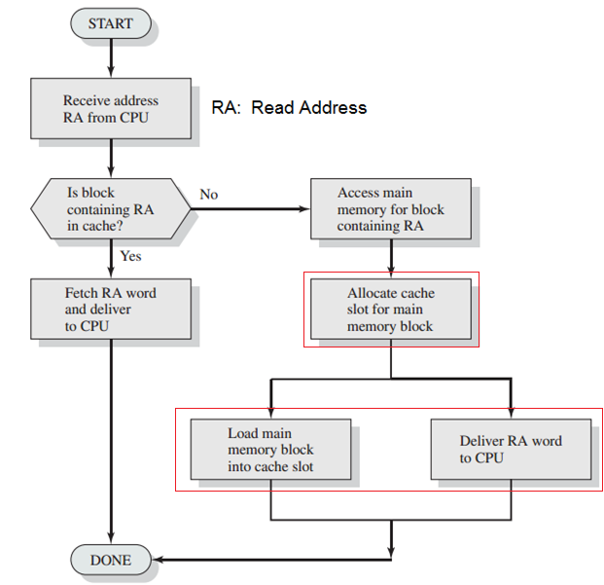
Notes:
Notice the two operations that are executed concurrently (in parallel).

Slide 41
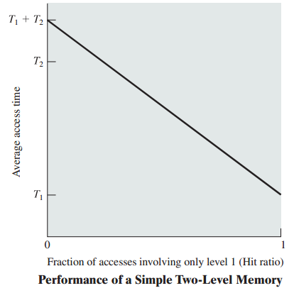
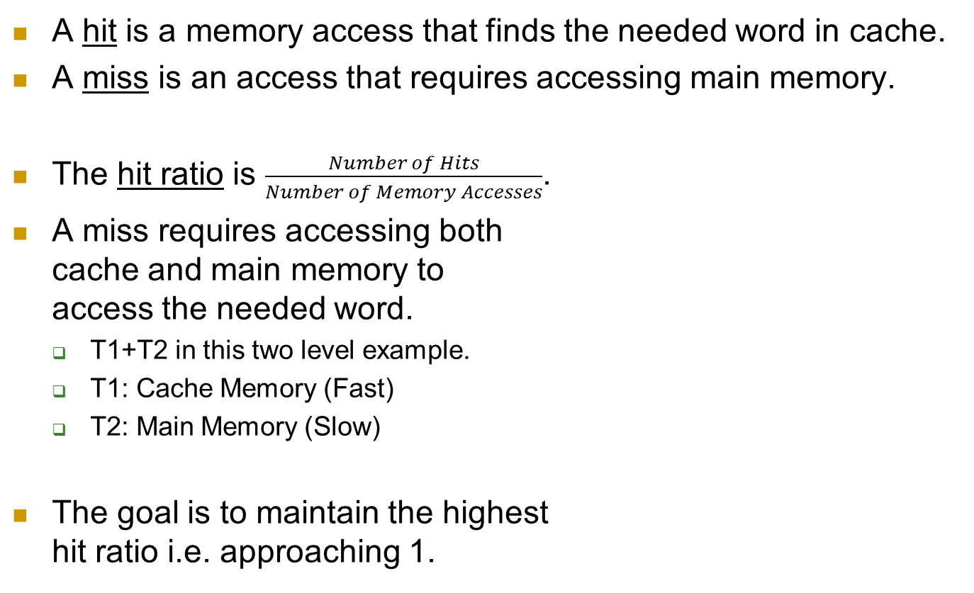
Hit Ratio
A hit is a memory access that finds the needed word in cache.
A miss is an access that requires accessing main memory.
The hit ratio is $\frac{Number of Hits}{Number of Memory Accesses}$.
A miss requires accessing both cache and main memory to access the needed word.
T1+T2 in this two level example.
T1: Cache Memory (Fast)
T2: Main Memory (Slow)
The goal is to maintain the highest hit ratio i.e. approaching 1.
Notes:
If the hit ratio = 0, every access is a miss requiring a T2 access (memory).
If the hit ratio = 1, every access is every access is a hit requiring only a T1 access (cache).
In this slide, T1 & T2 are access times measured from the lower left-hand corner of the graph.
Intel processor have an average hit ratio of .9 or 90%.

Slide 42
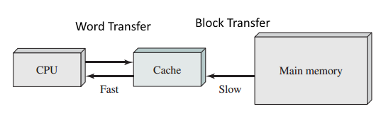
Memory is Transferred and Maintained in Cache in Blocks of Words
With hardware support, it is much faster to transfer one block of N words as opposed to N transfers of 1 word.
For example, a block size of 256 words.
How does Locality of Reference enhance the effectiveness of block transfers.

Slide 43
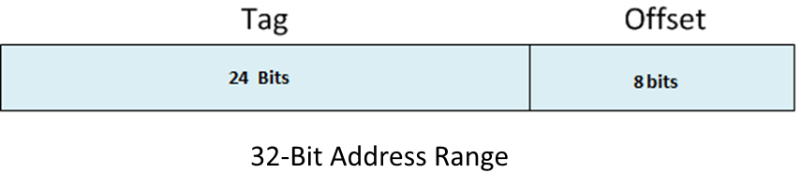
Identifying the Cache Block with a Specific Physical Memory Address
How to determine which cache block maintains the data found at a specific physical memory address?
A Physical Memory Address is divided into a tag and offset.
The tag is used to identify the cached block (line).
The offset identifies the addressed word within the cache block.

Slide 44

Cache Memory Addressing
For example, given a 32 Bit Address…
24 MSbits is the tag value used to identify the cache block.
If the block is present (i.e. a hit) in cache memory.
8 LSbits is the offset into the tagged cache block.
A block size of 256 words and 4096 blocks of cache will need roughly 1million words of SRAM cache memory.
Plus the tag lookup table / mechanism.
Notes:
In this example, the tag bits can address 2²⁴ or 16,777,216 possible cache blocks. In the following examples, only 4096 blocks (lines) of cache are provided. This means that only a fraction of main memory can be held in cache at any one time.

Slide 45
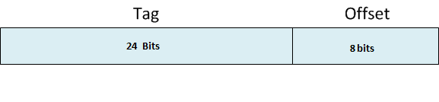
Managing Cache Blocks
In our example…
The 24 bit tag supports 2²⁴ (16 million) cache blocks of size 256 words.
But our process has only 4096 cache blocks.
So in this example, the cache can maintain only 0.00024 of the potential addressable memory blocks.
At some point during the system’s operation all of the cache blocks will be occupied.
How does the system decide which occupied block to discard in order to accommodate a new block?
The system utilizes a Cache Replacement Strategy.

Slide 46
Selecting an Occupied Cache Block For Replacement
A Cache Replacement Strategy is employed to select the occupied block that has the least negative effect on system performance.
The occupied block whose memory (instructions or data) is least likely to be accessed in the future.
The goal of the replacement strategy is to minimize the possibility of a cache miss on the replaced block.
The need to re-cache a block that was recently replaced i.e. overwritten.

Slide 47
Two Cache Replacement Strategies
First In First Out (FIFO) is a strategy that selects cache blocks to be replaced using a circular list.
The first block copied into cache is the first block replaced.
This strategy is sure to pick occupied blocks whose memory is being actively used ensuring a miss.
Least Recently Used (LRU) is a strategy that selects the cache block that was least recently accessed for replacement.
More effective use of cache but difficult to implement efficiently.
Many efficient algorithms that approximate LRU have been developed e.g. the Clock Algorithm in Section 7.

Slide 48
Modified (Dirty) Blocks
When the program writes into a memory location (data or stack), the block the location resides in becomes ‘dirty’.
Dirty (modified) cache memory blocks must be written back to main memory before the cache block is overwritten with a newly selected block.
Selecting a modified cache block for replacement will always require twice the number of memory accesses …
The first to write the modified cache block back to main memory.
The second to read the block from main memory into cache.

